Slide 1

Scipionbox: A framework towards Integration and Reproducibility in 3D Electron Microscopy
Escuela Politecnica Superior
Instruct Image Processing Center, CNB-CSIC
Roberto Marabini Ruiz
Notes:
1
Hello, I am Roberto Marabini
1

Slide 2
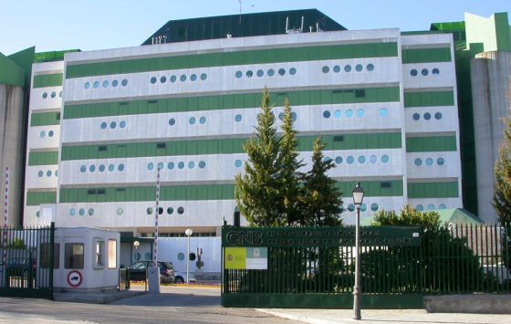


Escuela Politecnica Superior
Instruct Image Processing Center, CNB-CSIC
Roberto Marabini Ruiz
Notes:
In this talk we would like to summarize how ScipionBox is used at the CNB.
If I am wrong please correct me.

Slide 3
Please correct me
if I am wrong
Notes:
In this talk I would like to summarize how ScipionBox is used at CNB.
Most of you either develop or work wirh Scipion
So please correct me If I am wrong

Slide 4
Goal
Detect problems at early stages:
microscope
sample
Save computing time
Notes:
From my point of view this are the main goals of Scipion box
Detect problem in early stages: for example shift in the electron beam
Data quality: move to another area
Save computing time: process while you collect
4

Slide 5
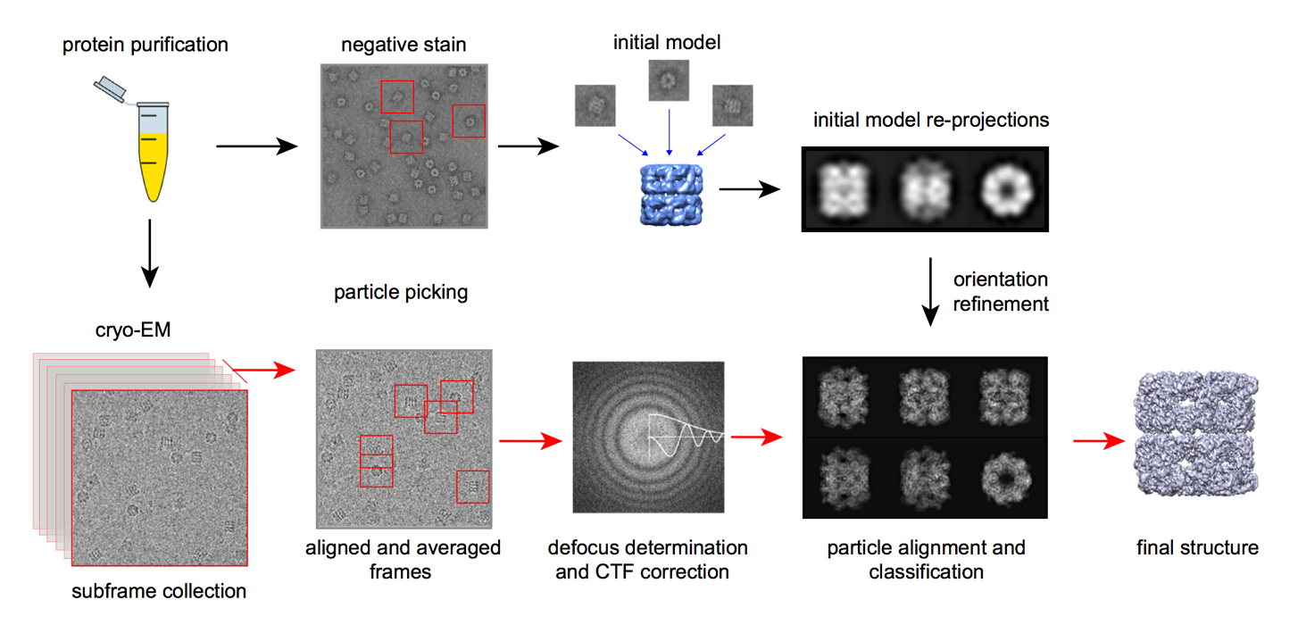
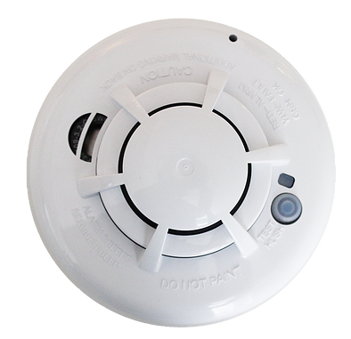


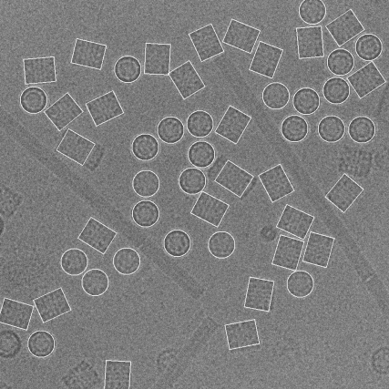
Workflow – Monitor – Report - API
movie collection
particle picking
Notes:
In order to satisfy the 3 mentioned requirements scipionbox needs to implement a workflow similar to this one. At present, at CNB, we are running this part, soon we will add this extra protocol and finally this are long term projects. In addition to the workflow scipoionbox also need to incorporate monitor that alert users. It should be able to create reports on the different jobs and finally should be able to connect with other software.

Slide 6
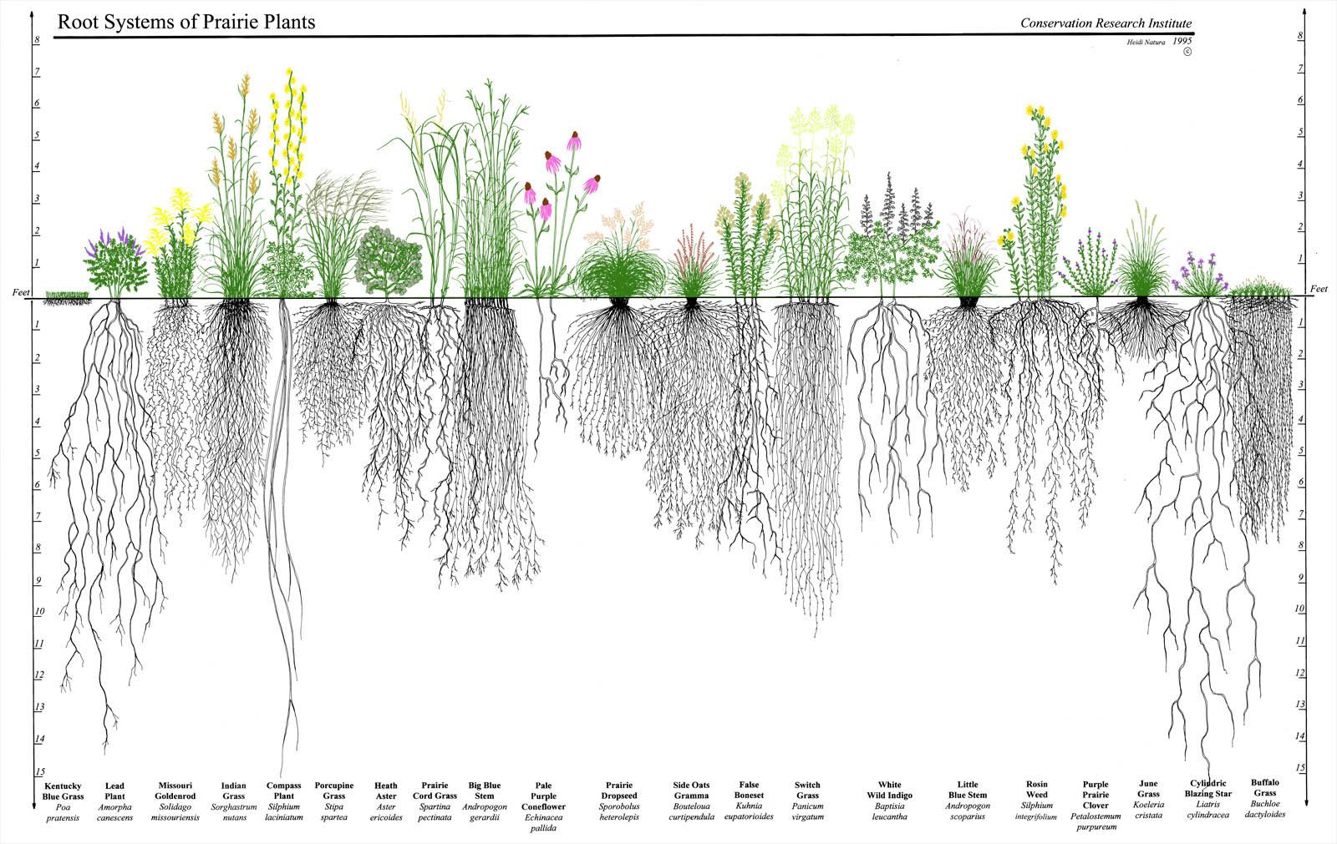
What People See
What Happens Underneath
Notes:
I have divided therest of the talk talk in two main parts.
In the first one I will present the user perspective
while in the second part a will follow the developer point of view.

Slide 7
SetUp
At
CNB
Notes:
Present what we do
Focusing on
Overview
And I would like to present you the work we develope at the I2PC in the area of image processing.
Let me show in a single slide the kind of work we do and then I will focus on workflows and data management
7

Slide 8
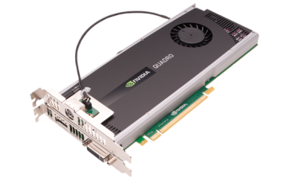
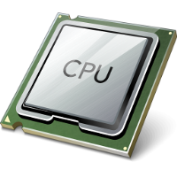
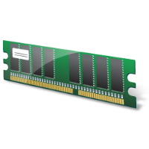
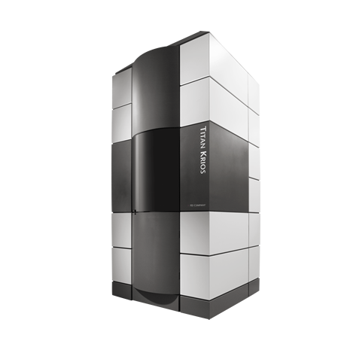





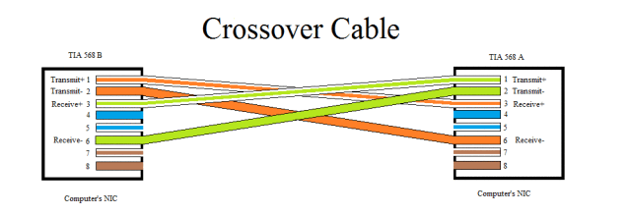


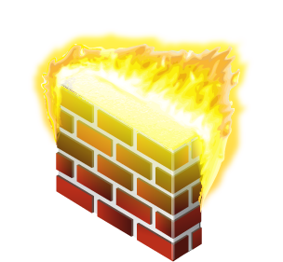
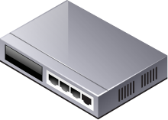


32 x
64 x
Control Mic.
Local Storage
1 Gbit/sec
USB-3
Firewall
1 Gbit/sec
Microscope
BBCP
(5031)
LAN Storage
WAN Storage
/ processing
Cloud Processing
Notes:
bbcp does not encrypt the data stream

Slide 9
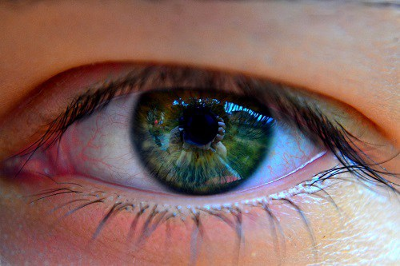
User Point of View
Notes:
Let us start with the user point of view
9

Slide 10
32 x
64 x
Control Mic.
Local Storage
1 Gbit/sec
USB-3
Firewall
1 Gbit/sec
Microscope
BBCP
(5031)
LAN Storage
WAN Storage
/ processing
Cloud Processing
Notes:
bbcp does not encrypt the data stream

Slide 11
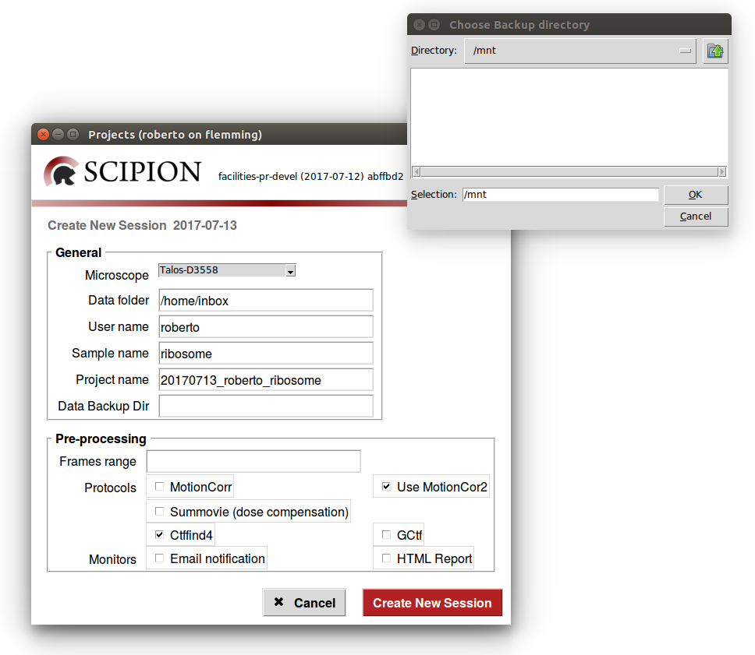
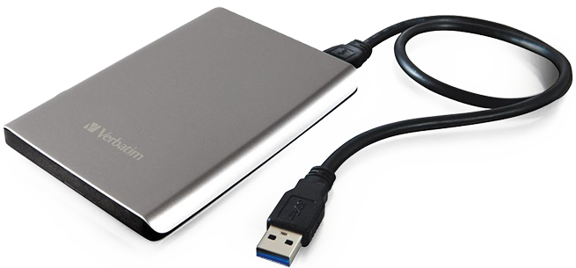

ScipionBox: launch
roberto@clark.cnb.csic.es:
scipion-newsession
http://scipion.cnb.csic.es/scipionbox/project_name
Notes:
Type command at terminal
Decide
1) backup
2) workflow
3) email and report

Slide 12
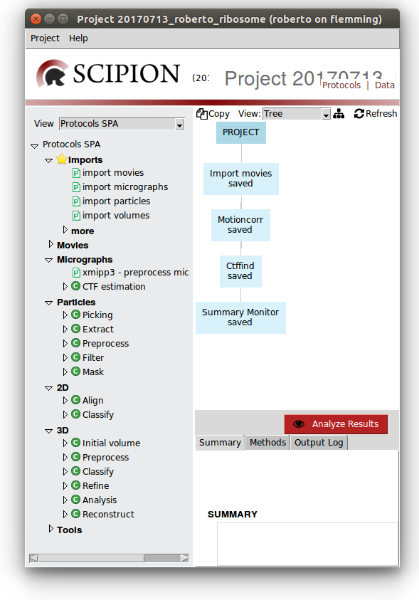
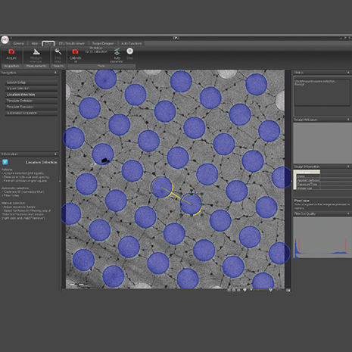
Control Mic: Select
20170713_roberto_ribosome ├── GRID_01 │ ├── ATLAS │ └── DATA
| … ├── GRID_12 │ ├── ATLAS │ └── DATA └── ScipionUserData └── projects └── 20170713_roberto_ribosome
Notes:
Como se asigna EPU to directorio

Slide 13
Control Mic: Select
Notes:
Como se asigna EPU to directorio

Slide 14

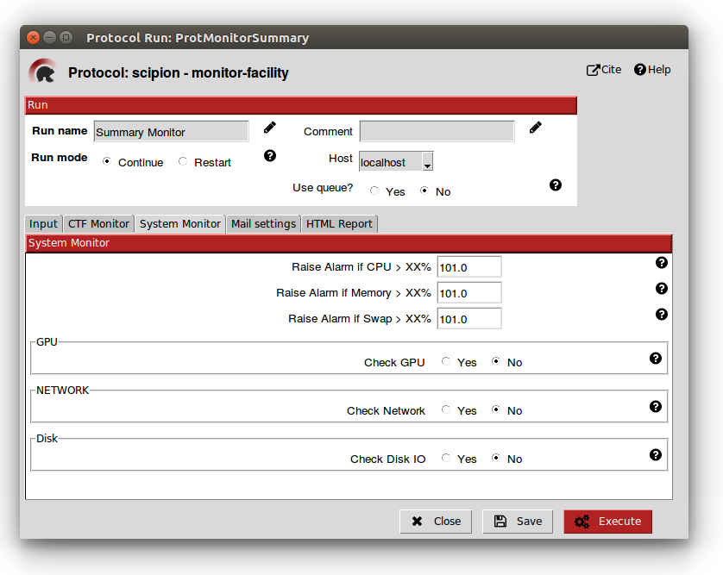

Execute

Slide 15
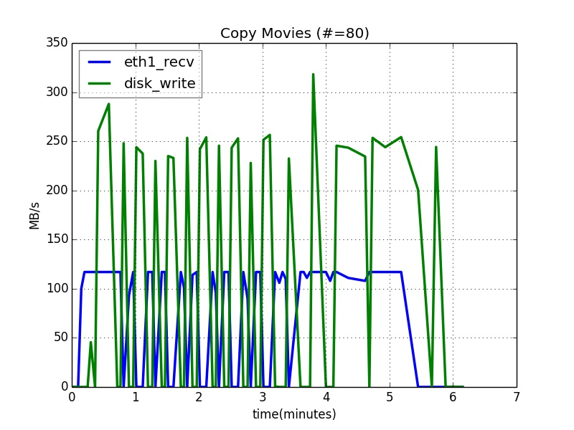
System Monitor

Slide 17
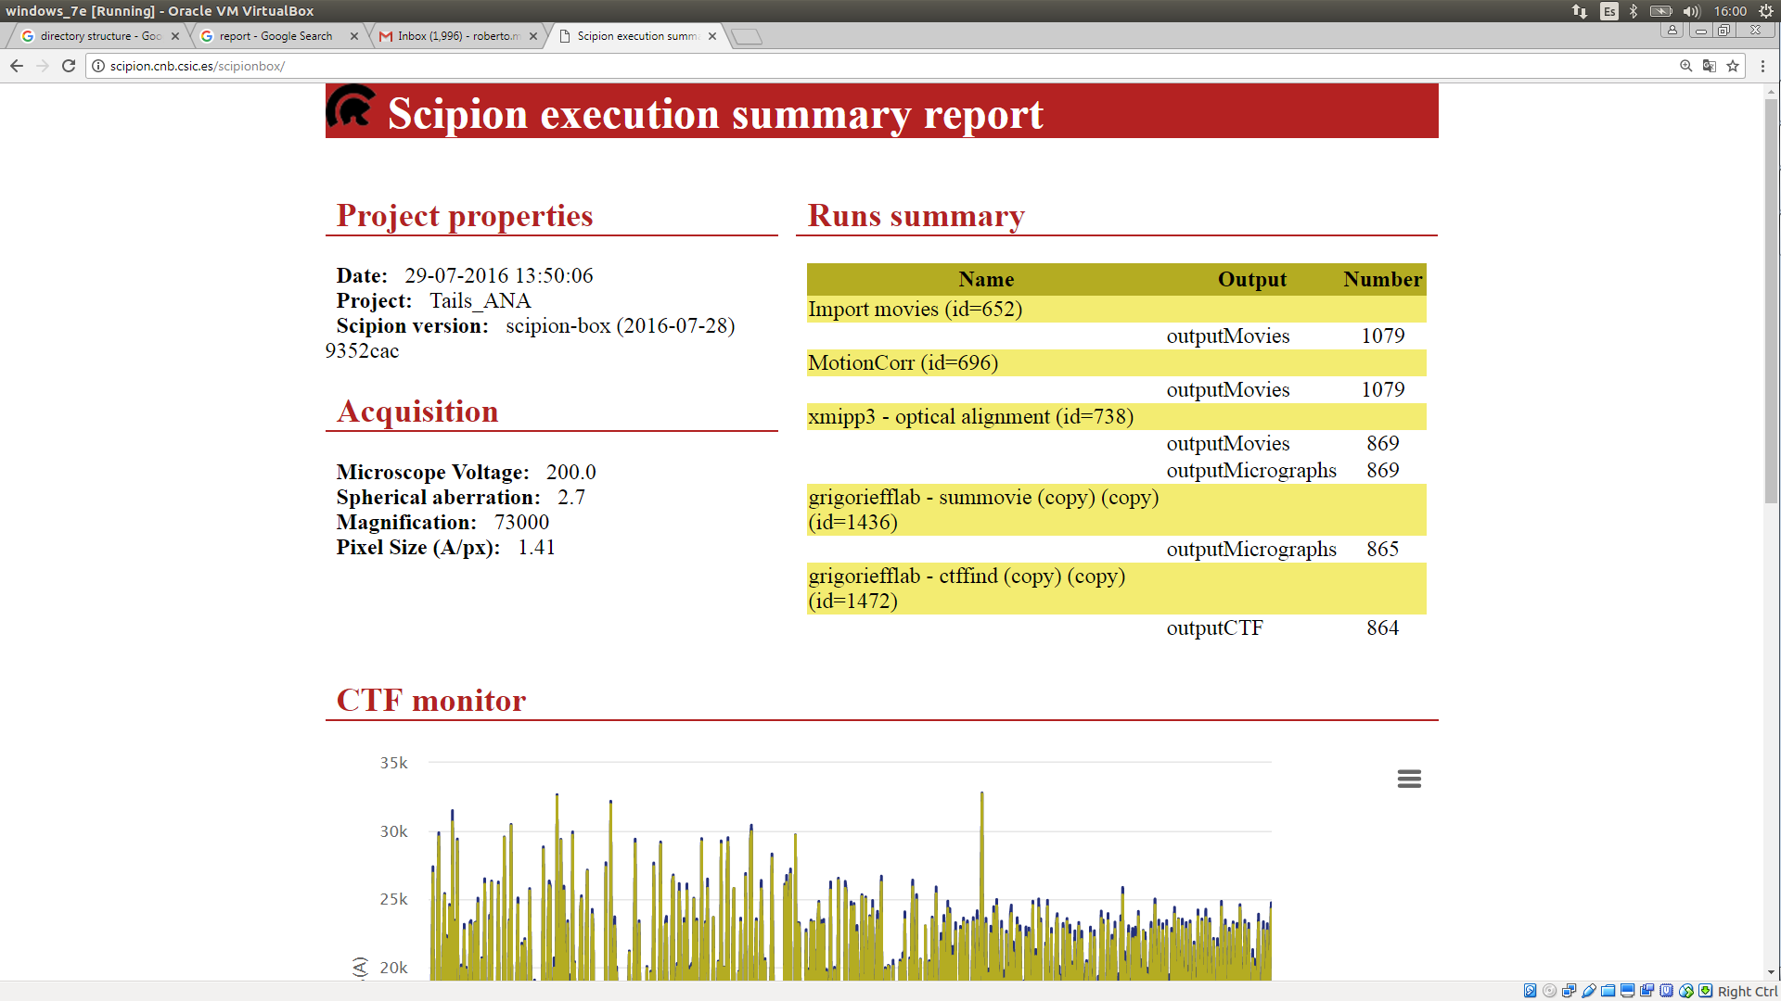

Report
Last pictures
http://scipion.cnb.csic.es/scipionbox/project_name

Slide 18
Workflow – Monitor – Report - API
movie collection
particle picking
Notes:
In order to satisfy the 3 mentioned requirements scipionbox needs to implement a workflow similar to this one. At present, at CNB, we are running this part, soon we will add this extra protocol and finally this are long term projects. In addition to the workflow scipoionbox also need to incorporate monitor that alert users. It should be able to create reports on the different jobs and finally should be able to connect with other software.

Slide 19

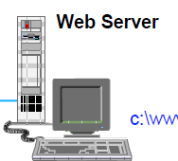
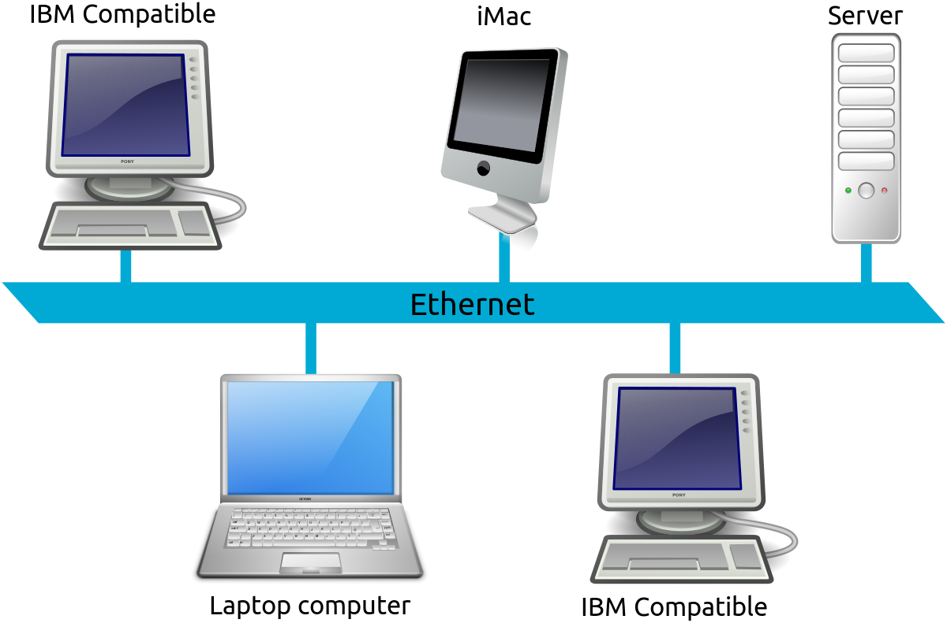

Slide 20
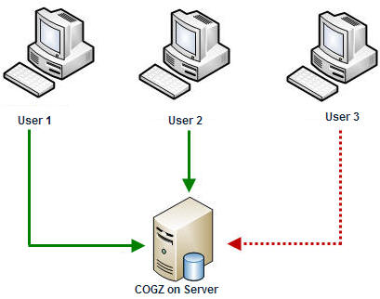
Limitations
Concurrency
Notes:
Concurrence
GPU-CPU

Slide 21
Developer Point of View
Notes:
Let us now analyze the behaviour of scipionbox at CNB from a developer point of view
21

Slide 22

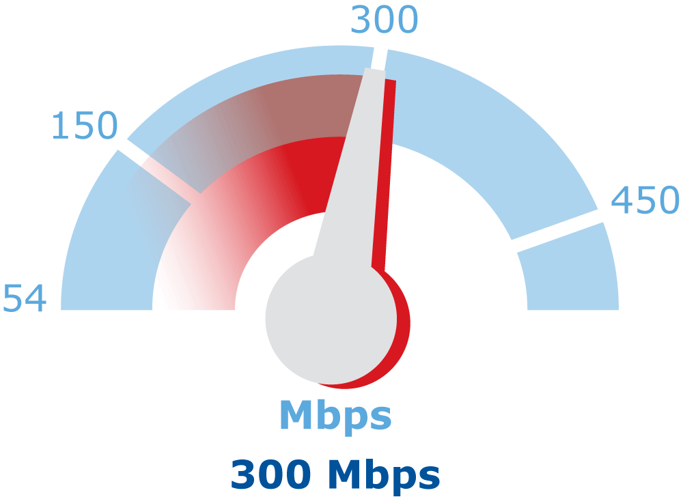
Notes:
What I want to show you here is what is the impact of each process in the computer. What we have done is to meassure transfer rates, GPU usage etc.

Slide 23
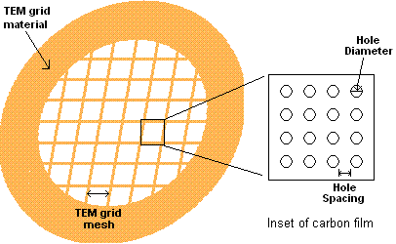
Materials and Methods
Frames per movie | 18
Number Movies | 6321
Total Acquisition time | 4 days (7 hours preparation)
Time per Movie | 55 sec
Time per Movie (mode) | ~17 sec
Dose per frame | 1.68 e/A
Total Dose | 29 e/A
Voltage | 200 Volt
Dose Filter=0 | 24 e/A
Movie Size | 623 MB
The value that appears more often
8.25 sec, movie

Slide 24

Notes:
People see this
What really happend

Slide 25




Disk write
Net recv
8.25 sec, movie
Notes:
How much time is spent moving a movie to scipion box?
80 images, no periodicity
80 -> movies (cp_movie.bat) -> 8.25 sec, movie
19 -> 623K
32->1.049K
Comentar 17 es el target

Slide 26
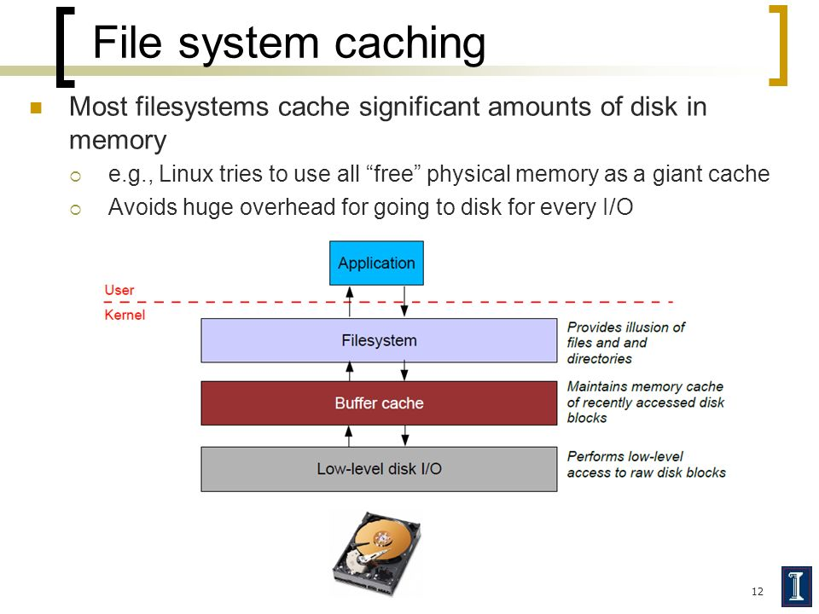
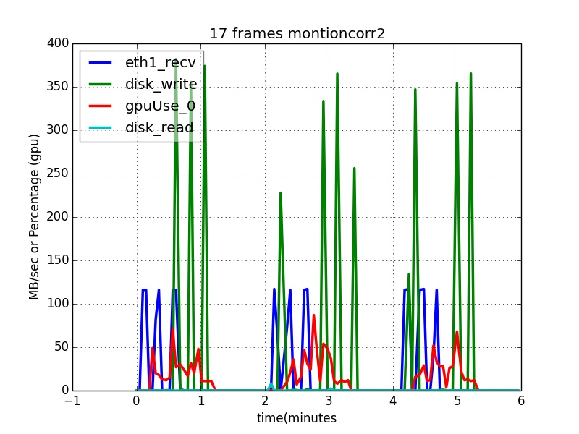
Control Mic.
1 Gbit/sec
Transfer
Write
Read
GPU (th)
Notes:
Recv by eth1
Delayed write but in cycle
NO READ (buffer) – do not delay if you want to use buffer
GPU activity//half cycle so OK but see next overhead --< better results 2 threads
Generate each 17 seg and then wait 60 sec each 3 run motion coor -nothing -add backup -add network
Explicar wen detalle sistema de buffer

Slide 27
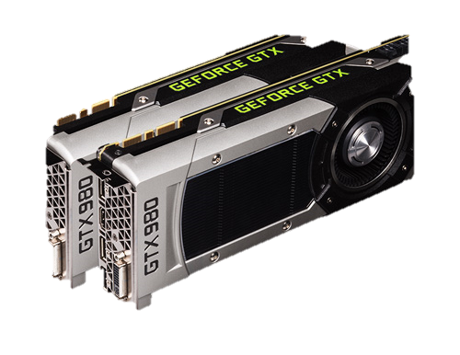
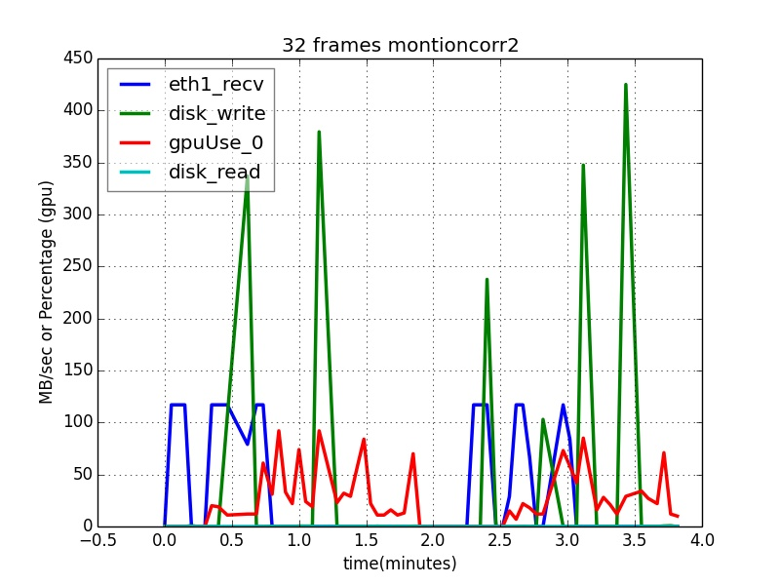
Notes:
With 32 (titan) no much difference in adquisitiont time but here is not much free GPU. Two GPUs is a must

Slide 28
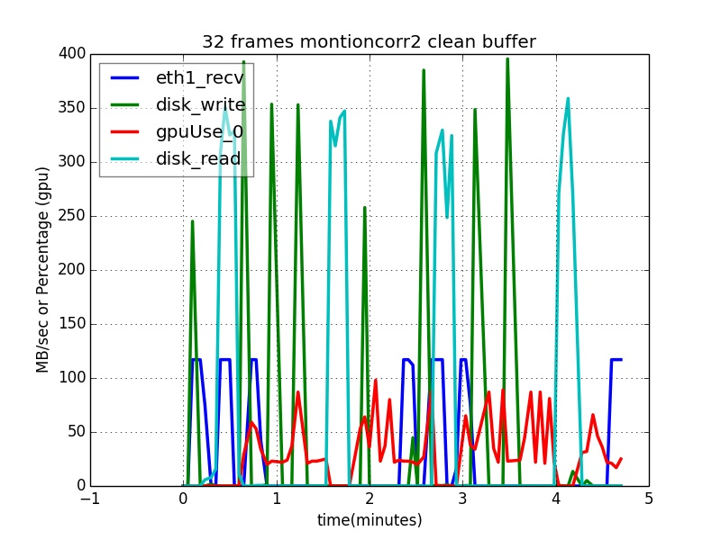
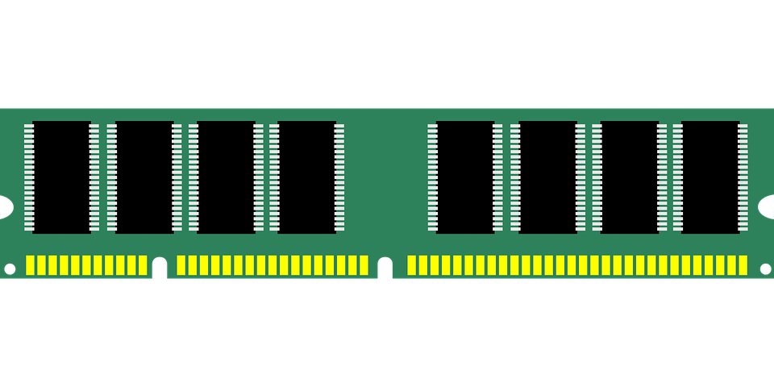
Motioncorr2 50 -> 1.10 min.
Notes:
Now we have read and the pace is equal.
Por que se puede llegar a esta situacion

Slide 29
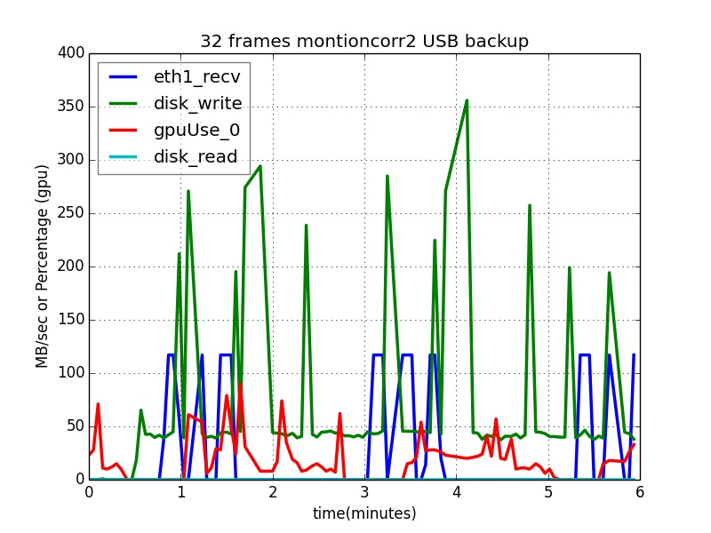
Notes:
Read is bad so what about local backup, with and without reading

Slide 30
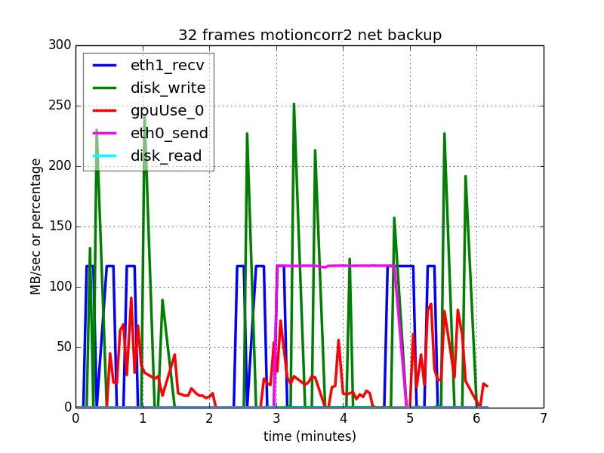

Notes:
Lan backup
Show disk read –write lan1 lan2
Consistencia de colores

Slide 31
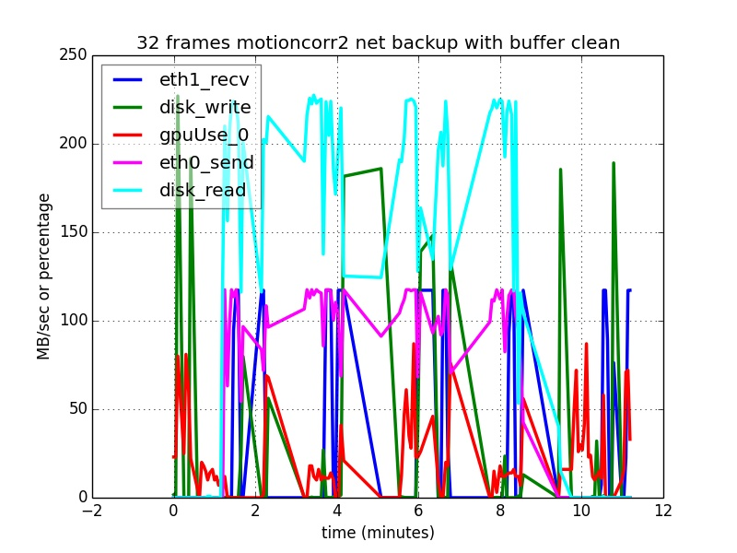

Slide 32
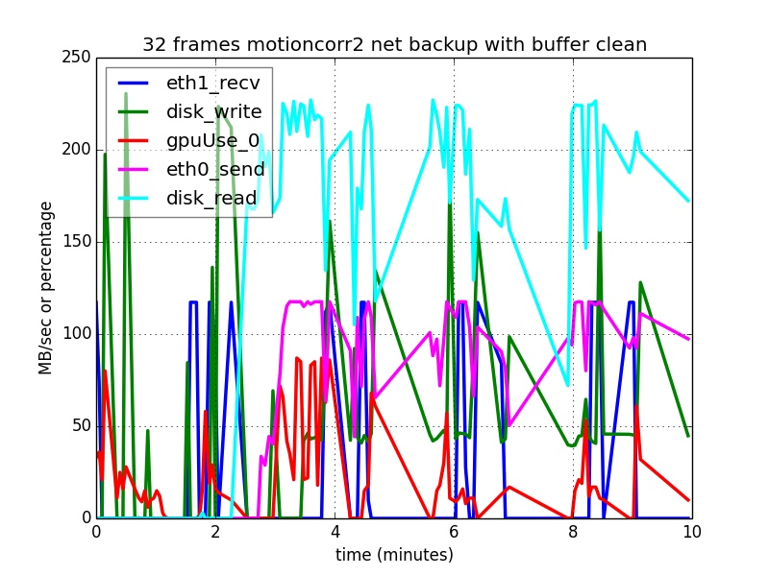


Slide 33
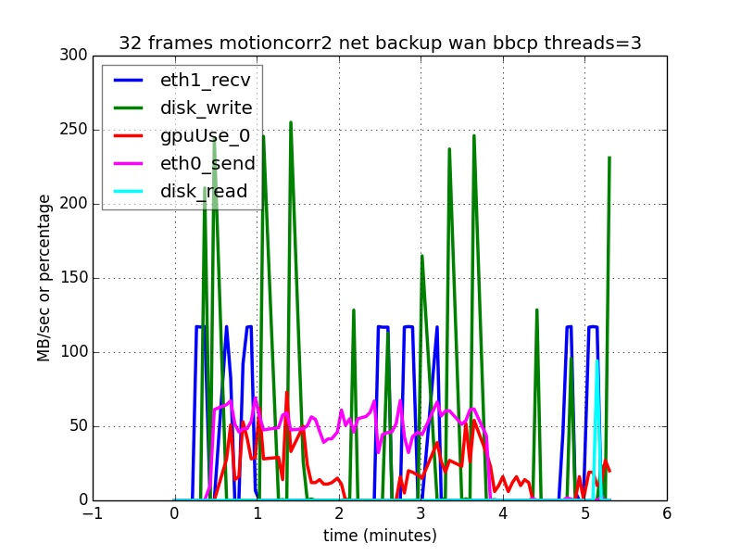
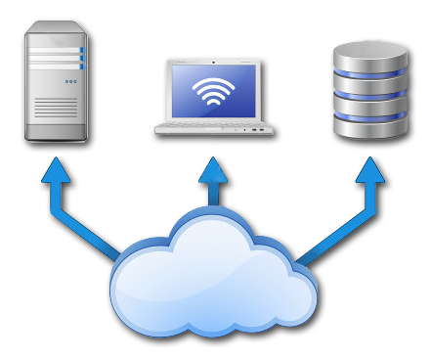
Port = 5031

Slide 34
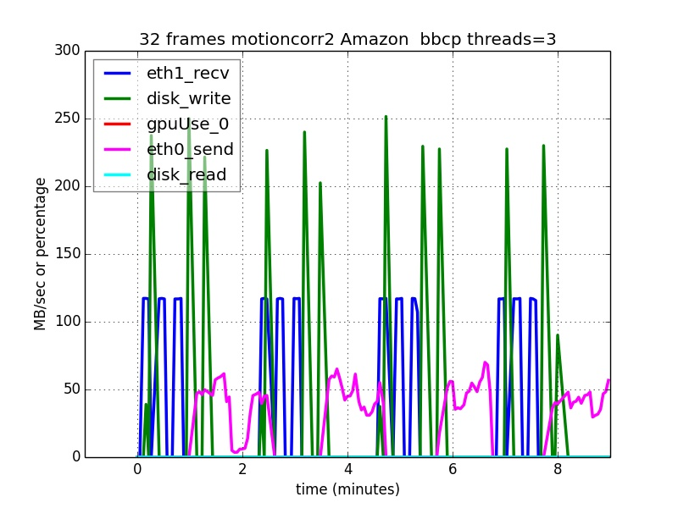

Slide 35
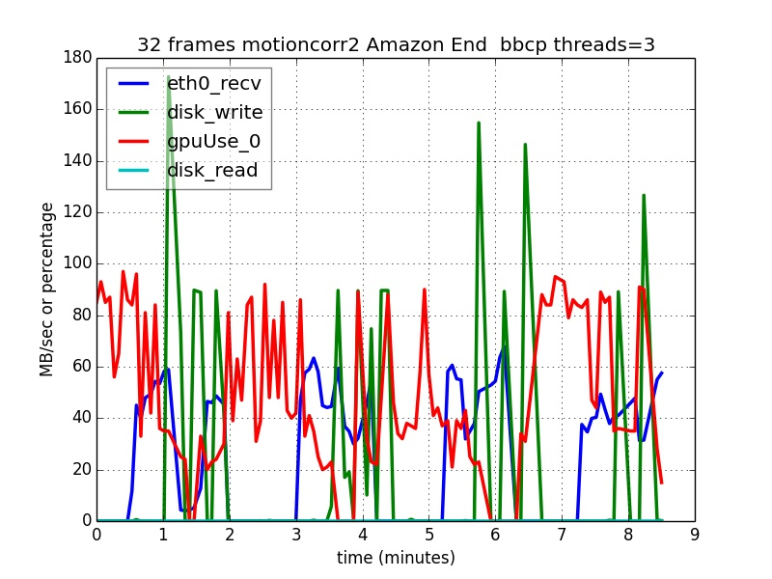
Notes:
Emails, sms, web server

Slide 36
In Summary
Notes:
Present what we do
Focusing on
Overview
And I would like to present you the work we develope at the I2PC in the area of image processing.
Let me show in a single slide the kind of work we do and then I will focus on workflows and data management
36

Slide 37
Current Set up (1 GPU, 64 GB, 32 CPUs) is OK for current necessities providing there is no concurrency. But Falcon III is comming
Movies can be transferred to remote locations in real time.
Recommend a second GPUs and two independent disk, one for acquisition, other for storage.
Reinforce backup in real time.
Warnings and reports not very popular.
Should we allow direct access to ScipionBox?
Notes:
Present scipion script
-- report
-- email and warning
-- backup
--
Conclusion

Slide 38


Slide 39
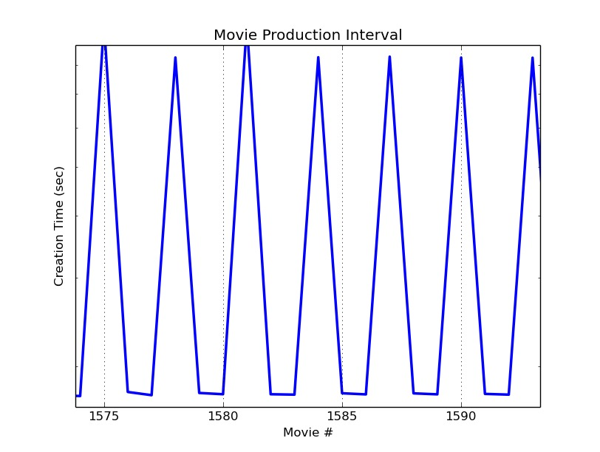

Notes:
TODO: rcontinuar, importar -> importar movies dos veces, motioncor
-> Execute all
-> parada NN hours no suficientes posiciones continue

